Slide 1
Networking for Software Developers
Lecture 5 – Summer 2024

Slide 2
Agenda
Protocol Basics
Application Layer
HTTP
DNS

Slide 3
Protocol Basics

Slide 4
Protocol
Protocols – set of rules and standards that define a language that nodes can use to communicate
Abstract objects that make up the network layers
Each protocol defines two different interfaces:
Service interface define the operations that local objects can perform on the protocol
Peer interface defines the form and meaning of messages exchanged between protocol peers

Slide 5
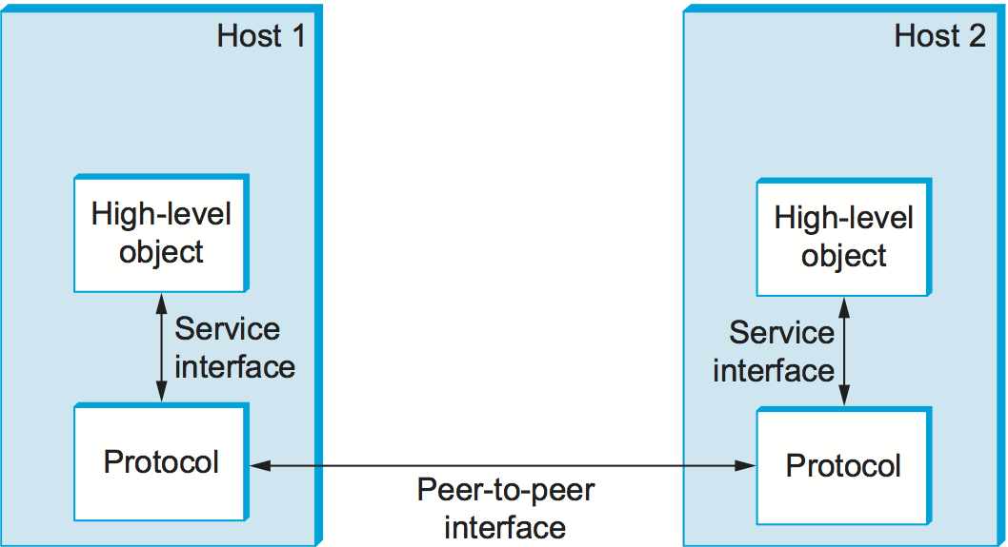
Protocol

Slide 6
Protocol Graph
Protocol graph – represent the suite of protocols for a network system
Nodes of the graph correspond to protocols
Edges represent dependencies and links between higher and lower-level protocols

Slide 7
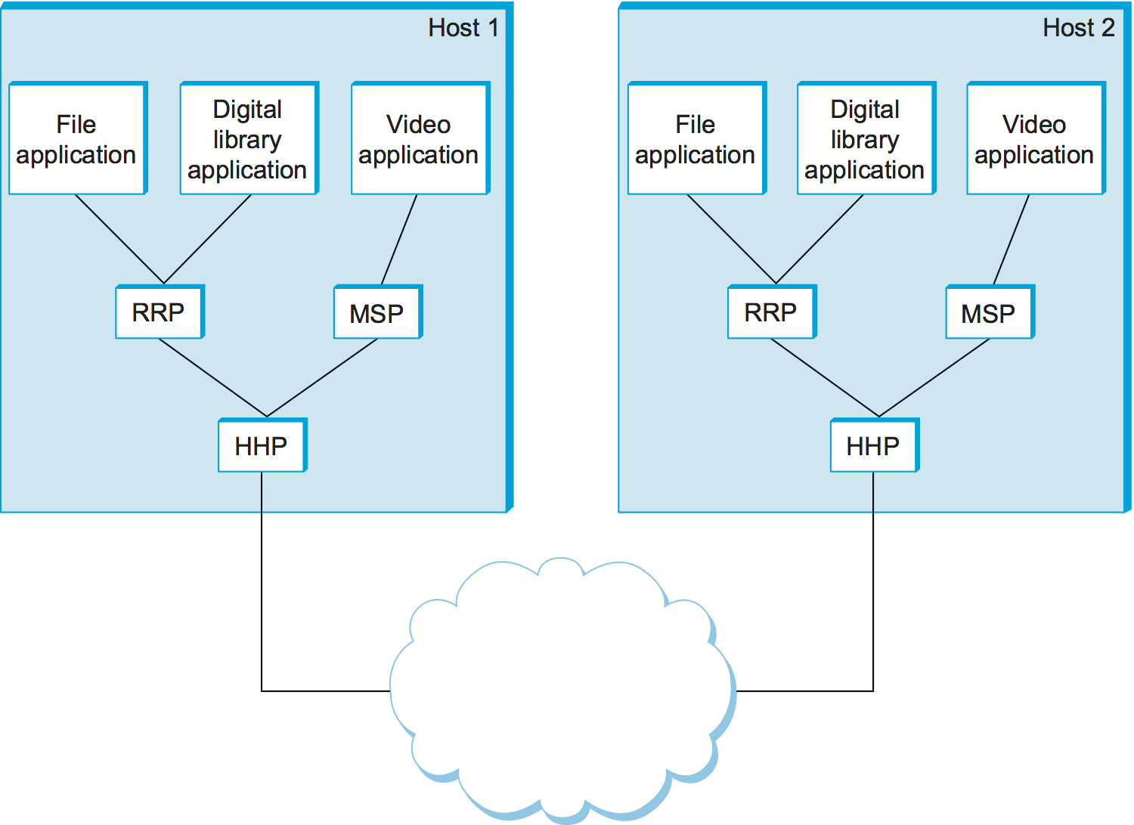
Protocol Graph
Protocol Graph examples:
RRP (Request/Reply Protocol) and MSP (Message Stream Protocol) implement two different types of process-to-process channels
Both depend on the Host-to-Host Protocol (HHP) which provides a host-to-host connectivity service

Slide 8
Protocol Transmission
How do messages or information move between the layers?
This requires the use of:
Encapsulation
Multiplexing and demultiplexing

Slide 9
Protocol Transmission
Encapsulation enables the addition of control information to messages for peer-to-peer communication
Header is a small data structure to add information and is attached to the front of the message
Trailer is a small data structure to add information and is attached to the end of the message
Header
Message Body or Payload
Encapsulated Message

Slide 10
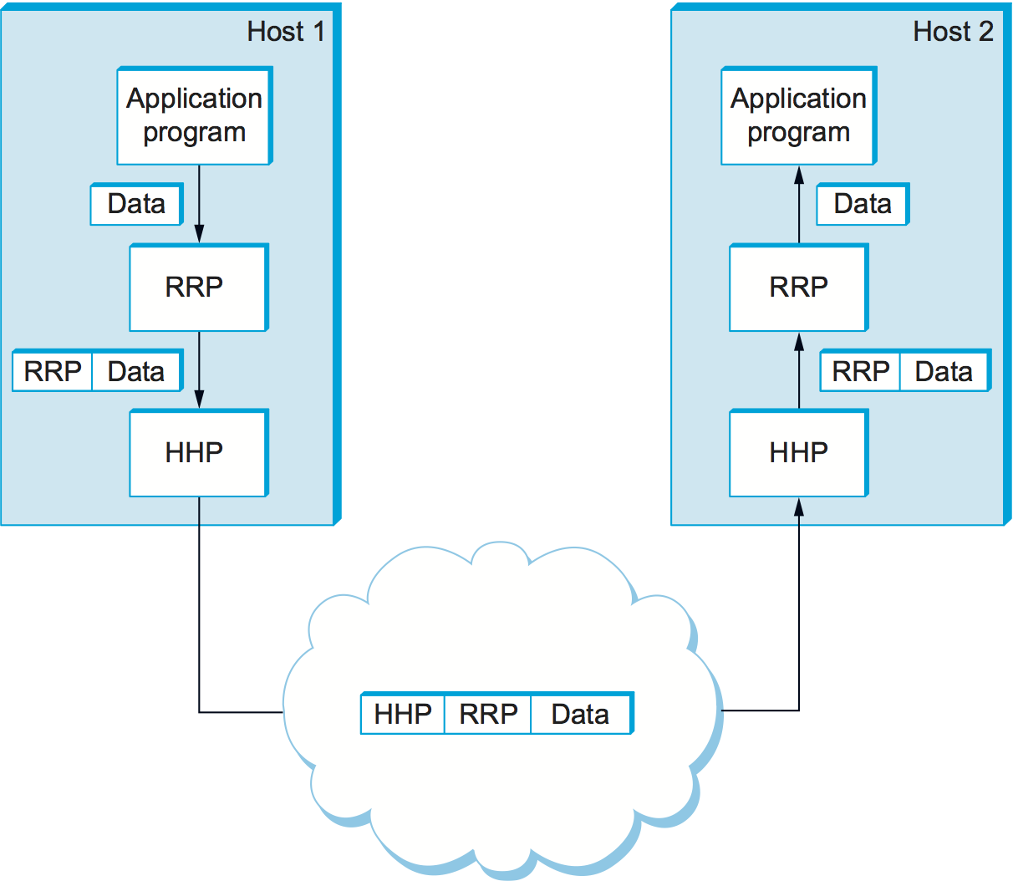
Protocol Transmission
It is possible to relate protocol graph to encapsulation
Low-level protocol do not interpret or extract message from high-level protocol
Low-level protocol may apply transformations to the data (e.g., compression, encryption, etc.) that transforms the entire message body

Slide 11
Protocol Transmission
Multiplexing (Muxing) – process and technique of transmitting multiple input signals or data streams over a single channel
Select and route several inputs to a single output
Demultiplexing (Demuxing) – process of reconverting a multiplexed signal or data stream into the original separate signals or data streams
Select and route one input into several single outputs
Increase the efficiency of the communication system by allowing the transmission of data (e.g., audio and video data transmission)

Slide 12
Application Layer

Slide 13
Application Layer
Highest-level layer to facilitate application-to-application and end-user-to-application interactions
Specifies the shared communications protocols and interface methods used by hosts in a communications network
Supports a variety of functions:
Identify communication partners
Determine resource availability
Synchronize communication
Etc.

Slide 14
Application Layer
Protocols include:
TELNET (Teletype Network)
FTP (File Transfer Protocol)
SMTP (Simple Mail Transfer Protocol)
SNMP (Simple Network Management Protocol)
DNS (Domain Name System)
DHCP (Dynamic Host Configuration Protocol)
HTTP (Hypertext Transfer Protocol)
Etc.

Slide 15
Application Layer Protocol
Specifications identifies:
Types of messages exchanged
Message syntax
Message semantics
Processing rules

Slide 16
Application Layer Protocol
What are common properties between protocols?
Reliable Data Transfer
Some apps (e.g., File transfer, web transactions) require 100% reliable data transfer
Other apps (e.g., Audio) can tolerate some loss
Timing
Some apps (e.g., Internet telephony, interactive games) require low delay to be effective

Slide 17
Application Layer Protocol
What are common properties between protocols?
Throughput
Some apps (e.g., Multimedia) require minimum amount of throughput to be effective
Other apps (“elastic apps”) make use of whatever throughput they get
Security
Encryption, data integrity, endpoint authentication, etc.

Slide 18
Hypertext Transfer Protocol (HTTP)

Slide 19
HTTP
Web page consists of objects, each of which can be stored on different web servers
Object can be HTML file, JPEG image, java applet, audio file, etc.
Web page consists of base html-file which includes several referenced objects, each addressable by a URL
URL
www.somebusiness.ca/someDept/pic.gif
host name
path name

Slide 20
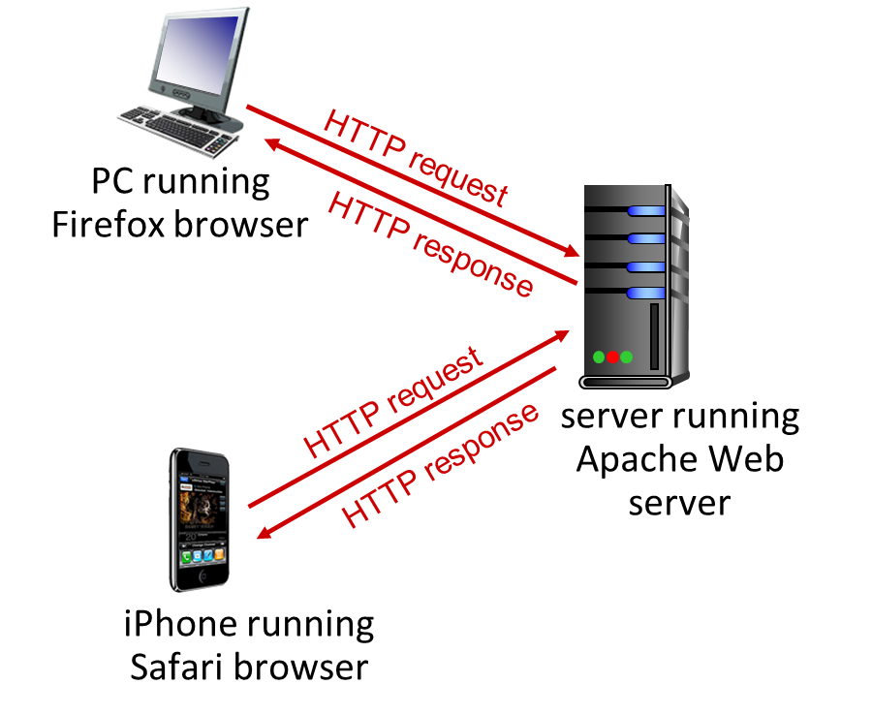
HTTP
Hypertext Transfer Protocol (HTTP) is a web application-layer protocol that supports a client/server model:
Client: browser that requests, receives, (using HTTP protocol) and “displays” web objects
Server: web server sends (using HTTP protocol) objects in response to requests

Slide 21
HTTP
HTTP uses TCP
Client initiates TCP connection (creates socket) to server, port 80
Server accepts TCP connection from client
HTTP messages (application-layer protocol messages) exchanged between browser (HTTP client) and web server (HTTP server)
TCP connection closed
HTTP is stateless
Server maintains no information about past client requests

Slide 22
HTTP
Connection types can be:
Non-persistent
Persistent

Slide 23

HTTP Non-persistent Connection
1a. HTTP client initiates TCP connection to HTTP server (process) at URL on port 80
1b. HTTP server at host www.someSchool.edu waiting for TCP connection at port 80 “accepts” connection, notifying client with response
1c. HTTP client sends acknowledgment corresponding to the response sent by the server
2a. HTTP client sends HTTP request message (containing URL). Message indicates that client wants object someDepartment/home.index
2b. HTTP server receives request message, forms response message containing requested object, and sends message to the client
time

Slide 24
HTTP Non-persistent Connection
3. HTTP server closes TCP connection
4. HTTP client receives response message containing html file, displays html. Parsing html file, finds 10 referenced jpeg objects
5. Steps 1-5 repeated for each of 10 jpeg objects
time

Slide 25
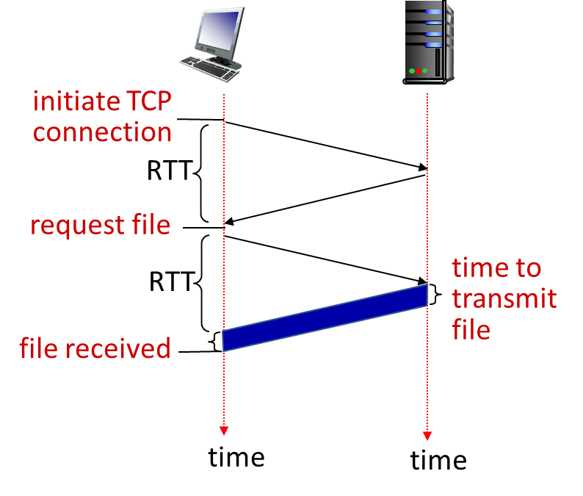
HTTP Persistent Connection

Slide 26
HTTP Versions
Issues with non-persistent HTTP (1.0):
Requires 2 RTTs per object
OS and hardware overhead for each TCP connection
Browsers often open multiple parallel TCP connections to fetch referenced objects in parallel

Slide 27
HTTP Versions
Resolved by persistent HTTP (1.1 or higher):
Server leaves connection open after sending response
Subsequent HTTP messages between same client/server sent over open connection
Client sends requests as soon as it encounters a referenced object
As little as one RTT for all the referenced objects (cutting response time in half)

Slide 28
HTTP Request
Specify the desired action to be performed on the destination (i.e., server):
Request messages comprises of:
Request line (method field, URL field, HTTP version field)
Header lines (host, connection, user agent, etc.)
Entity body
GET
POST
PUT
HEAD
DELETE
PATCH
OPTIONS
CONNECT

Slide 29
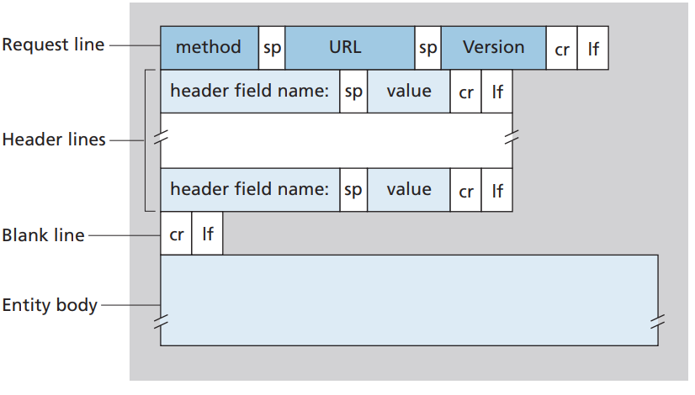
HTTP Request

Slide 30
HTTP Response
Outcome from action by the destination (i.e., server)
Response messages comprises of:
Status line (protocol version field, status code, status message)
Header lines (connection, date/time, created or last modified date/time, server, content length, content type, etc.)
Entity body

Slide 31
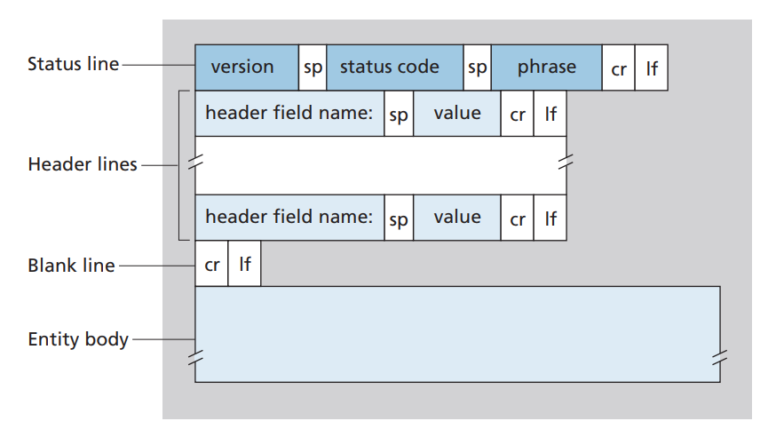
HTTP Response

Slide 32
HTTP Header
Constructed with a colon-separated key-value pairs in clear-text string format
Sent and received by both the client program and server on every HTTP request and response
Generalized into 4 context domains:
General Header
Request Header (Request Line, Header Line, etc.)
Response Header (Status Line, Header Line, etc.)
Entity Header

Slide 33
HTTP Header
Or, categorized based on its information use or handling:
Connection
Keep-Alive
Authentication
Authorization
Age
Expires
Cache-Control
ETag
Content-Type
Content-Length
Accept-Language
Transfer-Encoding (TE)
Trailer
Do Not Track (DNT)
Cookie
Etc.

Slide 34
HTTP Status Code
Types of status codes:
1XX - Information
2XX - Success
3XX - Redirect
4XX - Client Error
5XX - Server Error

Slide 35
HTTP Status Code
Informational responses (100–199)
Successful responses (200–299)
200 – Ok
201 – Created
202 – Accepted
Redirects (300–399)
301 – Moved Permanently
304 – Not Modified
307 – Temporary Redirect
308 – Permanent Redirect

Slide 36
HTTP Status Code
Client errors (400–499)
400 – Bad Request
401 – Unauthorized
403 – Forbidden
404 – Not Found
408 – Request Timeout
Server errors (500–599)
500 – Internal Server Error
501 – Not Implemented
502 – Bad Gateway
503 – Service Unavailable
504 – Gateway Timeout
505 – HTTP Version Not Supported

Slide 37
Evolution of HTTP?

Slide 38
HTTP 2.0
Introduced as RFC in 2015 and continued to gain adoption
Functionality decreases (perceived) delay in multi-object HTTP requests of previous protocol versions that cause:
In-order responses
Head-of-line (HOL) blocking
Stalls in loss recovery
Overstepping congestion control mechanisms
Functionality is associated with Frame Interleaving, Message Prioritization and Server Pushing

Slide 39
HTTP 2.0
Data flow associated with HTTP 1.1:
O₁
O₂
O₁
O₃
O₂
O₃
O₄
O₄
Objects delivered in order requested: O₂, O₃, O₄ wait behind O₁

Slide 40
HTTP 2.0
Data flow associated with HTTP 2.0:
O₂
O₄
O₃
O₁
O₂
O₃
O₄
O₁
O₂, O₃, O₄ delivered quickly, O₁ slightly delayed

Slide 41
Domain Name System (DNS)

Slide 42
DNS
Distributed database implemented in hierarchy of many name servers
Application-layer protocol: hosts, DNS servers communicate to resolve names (address/name translation)
Note: core internet function, implemented as application-layer protocol
Complexity at network’s “edge”

Slide 43
DNS
DNS services include:
Hostname-to-IP address translation
Host aliasing (e.g., canonical or alias names)
Mail server aliasing
Load distribution for replicated web servers (i.e., many IP addresses correspond to one name)

Slide 44
DNS Servers
Root DNS Servers
Root
…
…
.com DNS servers
.org DNS servers
.edu DNS servers
Top Level Domain
…
…
…
…
yahoo.com
DNS servers
amazon.com
DNS servers
pbs.org
DNS servers
nyu.edu
DNS servers
umass.edu
DNS servers
Authoritative

Slide 45
DNS Servers
Root name servers function as the official, contact-of-last-resort by name servers that can not resolve name
Critical for the internet to function
ICANN (internet corporation for assigned names and numbers) manages root DNS domain
Top-Level Domain (TLD) servers:
Responsible for .com, .org, .net, .edu, .aero, .jobs, .museums, etc.
Responsible for all top-level country domains (e.g., .cn, .uk, .fr, .ca, .jp, etc.)

Slide 46
DNS Servers
Authoritative DNS servers function as the organization’s DNS server that provide hostname to IP mappings for organization’s named hosts
Can be maintained by organization or service provider
Local DNS server also play a critical role in the internet infrastructure and services
Facilitates, forwards, and returns queries and replies into and from DNS hierarchy for resolution
Create and maintain local cache of recent name-to-address translation pairs
Each ISP or organization has local one or more DNS name server

Slide 47
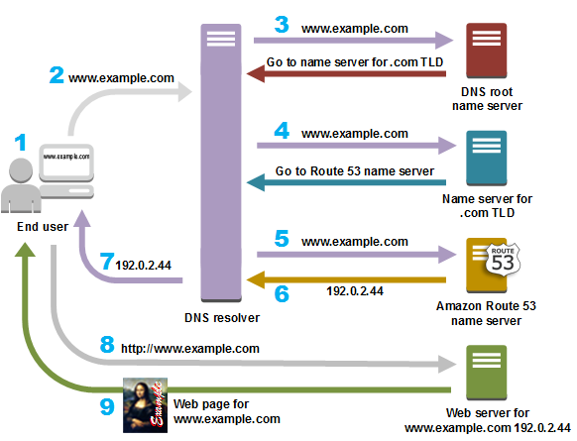
DNS Connection

Slide 48
DNS Records
For DNS registration and routing, a critical requirement is DNS record
There are several major types of DNS records:
A record
AAAA record
CNAME record
Nameserver (NS) record
Mail exchange (MX) record

Slide 49
DNS Records
Other types of DNS records :
SOA record
TXT record
PTR record
SRV record
CERT record
DNAME

